Slide 1
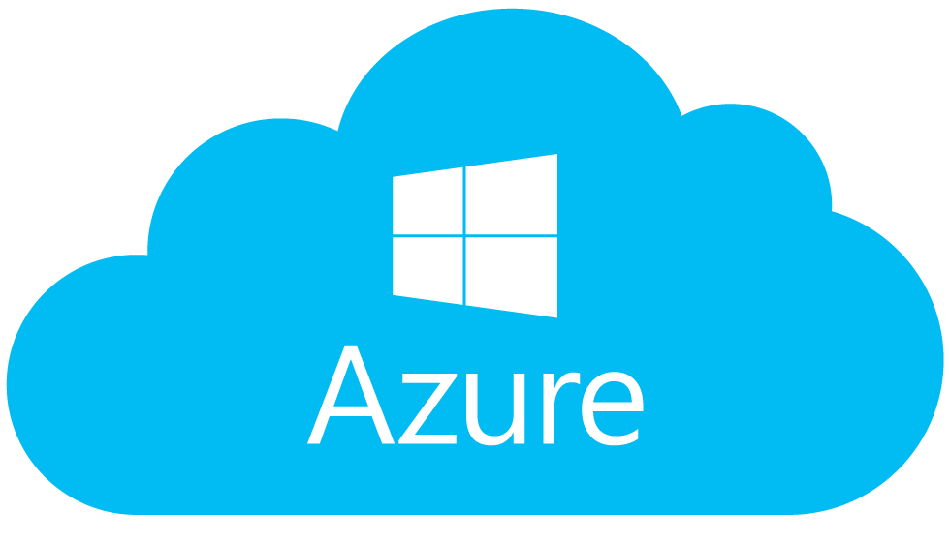
Azure Security
Parag Kamra

Slide 2
Agenda
Introduction to Azure
On premises vs Cloud
Azure Shared Responsibility Model
Azure Security Center
Azure Network Security Groups
Azure Database Threat protection
Azure Cloud Security Audit
Demo

Slide 3
Introduction to Azure
Azure is a public cloud computing platform created by Microsoft
34 Regions all over the world
6 new announced Regions
Service Models: IaaS, PaaS, SaaS

Slide 4
On premises vs Cloud Infrastructure

Slide 5
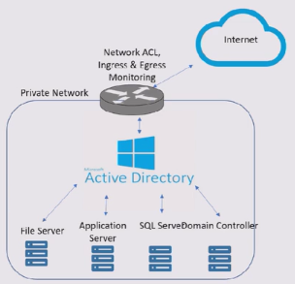
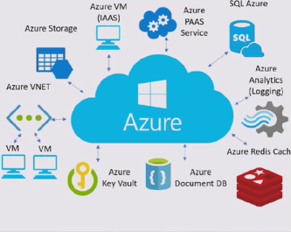
On premises
Cloud

Slide 6
Azure Shared responsibility Model

Slide 7
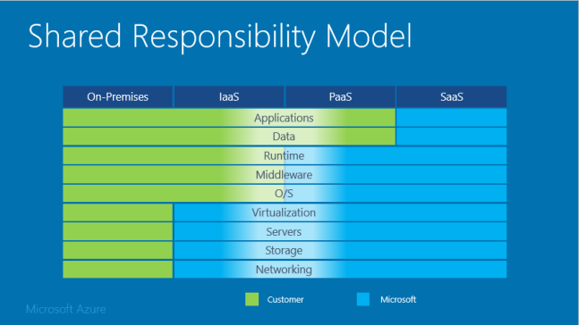
Azure Shared Responsibility Model
When talking about security in the public cloud, people ask “what are the main differences between security on-premises and security in the public cloud?”
If I had to call out the main difference between public cloud and on-premises security is Shared responsibility model.

Slide 8

Azure Security Center

Slide 9
Azure Security Service center
Azure Security Center, you get a central view of the security state of all of your Azure resources. At a glance, verify that the appropriate security controls are in place and configured correctly.
Works on Security Policies
Collect Data from Resource Group.
Recommendation for Vulnerability Assessment, OS Vulnerabilities, NSG etc.
In Simple words, SeCuRiTy MoNiToRiNG In CLOuD

Slide 10
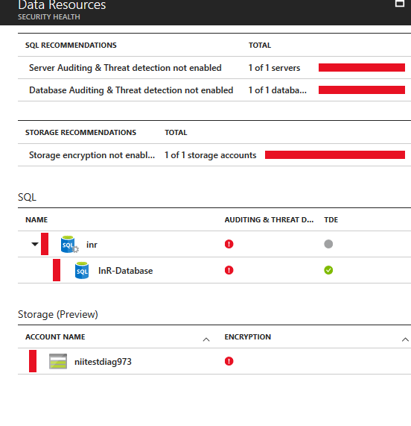
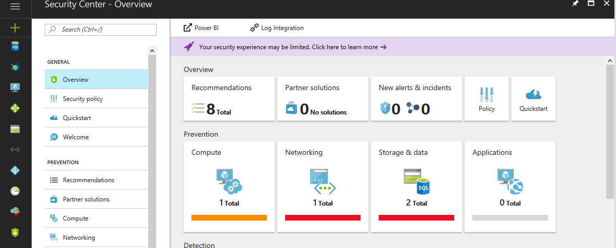
Azure Security Service Center

Slide 11
Azure Network Security Groups

Slide 12
Azure NSG
A network security group (NSG) contains a list of security rules that allow or deny network traffic to resources connected to Azure Virtual Networks (VNet). NSGs can be associated to subnets, individual VMs (classic), or individual network interfaces (NIC) attached to VMs (Resource Manager).
In simple words it acts as a firewall for Azure VM and Azure VNET.
Enables Network segmentation & DMZ Scenarios
Filter conditions with allow/deny individual addresses

Slide 13
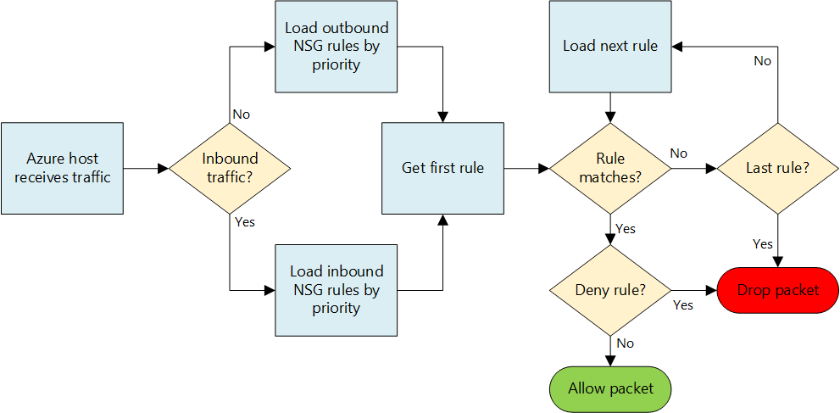
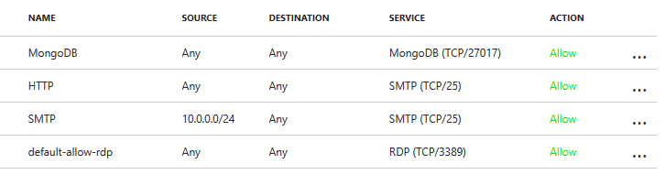
Azure NSG

Slide 14
Azure Database Threat protection

Slide 15
Azure Database Threat Protection
SQL Threat Detection provides a new layer of security, which enables customers to detect and respond to potential threats as they occur by providing security alerts on anomalous activities. Users will receive an alert upon suspicious database activities, potential vulnerabilities, and SQL injection attacks, as well as anomalous database access patterns. SQL Threat Detection alerts provide details of suspicious activity and recommend action on how to investigate and mitigate the threat.
Analyzes audit logs for possible threats
Works with any tier of SQL DB
Requires a storage accounts for audit logs

Slide 16
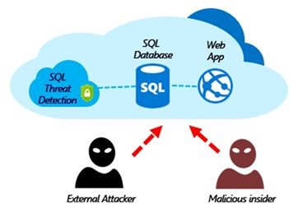
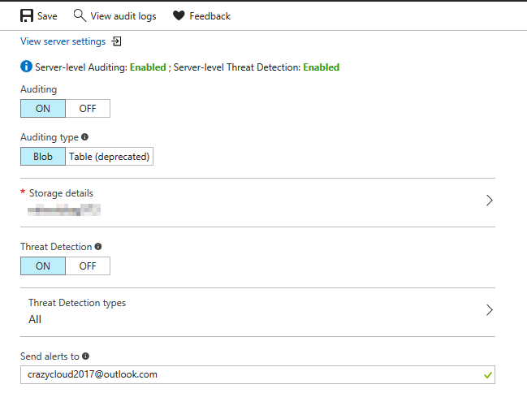
Azure Database Threat Protection

Slide 17
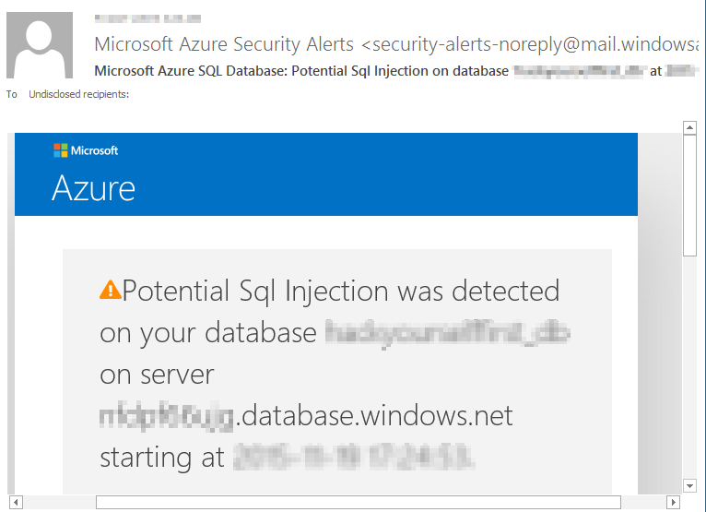
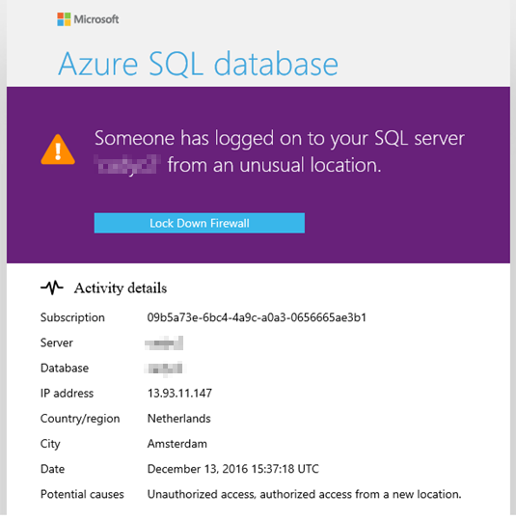
Azure Database Threat protection

Slide 18
Azure Cloud Security Audit

Slide 19
Azure cloud security Audit
Auditing Cloud services has become an essential task and significant effort is required to assess the security of the available resources. It requires knowledge about cloud services for example Azure VM, Azure VNET, Azure SQLDB, Azure Vault , IAM etc.
Example: You are cloud security auditor and you have to do audit for 60 Azure Virtual machines, 3 Azure Virtual Network, 25 Azure SQL Database, 5 Azure web applications. what you will do?

Slide 20

Azurite
Azurite was developed to assist penetration testers and auditors during the enumeration and reconnaissance activities within the Microsoft Azure public Cloud environment. It consists of two helper scripts: Azurite Explorer and Azurite Visualizer. The scripts are used to collect, passively, verbose information of the main components within a deployment to be reviewed offline, and visualize the association between the resources using an interactive representation.

Slide 21
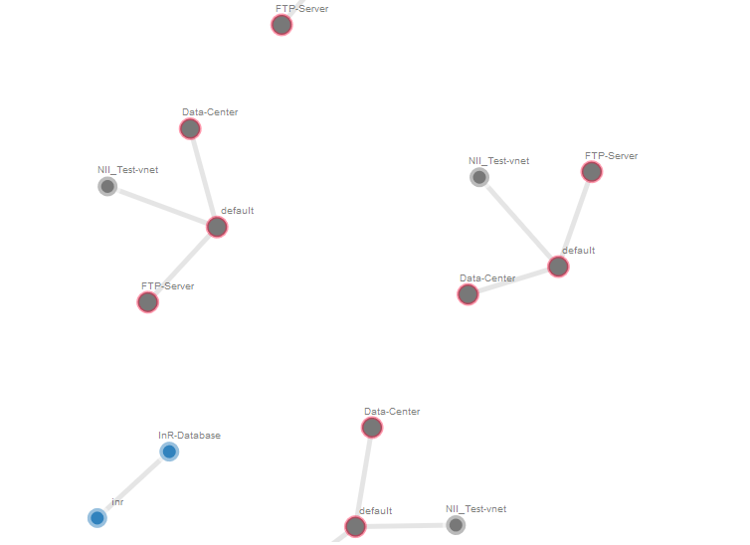
Azurite Visualization

Slide 22

Demo Time ☺

Slide 23
Questions?

Slide 24
Thank you ☺

